Slide 1

Computational Analysis of Religious and Ideological Linguistic Behavior
University of Virginia, MS in Data Science Capstone
Samantha Garofalo, Seth Green, Leigh Harton, Megan Stiles
Advisor: Don Brown
Client: Peter Ochs
Sponsor: ARL
Notes:
Sam

Slide 2
Notes:
Leigh

Slide 3
Problem: How to work with Value-Based Groups?
What is a value-based group?
Religious
Political
Any group motivated by a set of values
Who needs to work with value-based groups?
US Government
Humanitarian Groups
Business Leaders
Problem Objectives Technical Approach Results
Notes:
Megan

Slide 4
UVA Initiative on Conflict, Politics, and Religion
1-9 Linguistic Rigidity Scale
Number of definitions not the definition itself is what matters
Venuti et al. automated model
1 2 3 4 5 6 7 8 9
Holy
Self-Sacrifice
Compassion
Wisdom
Trustworthiness
Problem Objectives Technical Approach Results
Notes:
Megan

Slide 5
Objectives & Goals
Large-Scale Goals:
Real-time recommendations to organizations on the ground
Team Goals:
Tune the Signal Processing Model
Test a Deep Learning Model
Language Agnostic
Other Groups
Problem Objectives Technical Approach Results
Notes:
Sam

Slide 6
Technical Approach
Notes:
Sam

Slide 7
Technical Approach: Signal Processing
Performative Signals
Number of judgments (noun + “to be” verb + adj/adv)
Context Vectors (Semantic Density and Cosine Similarity)
Network Analysis (Eigenvector Centrality)
Semantic Signals
Topic Modeling
Sentiment Analysis
Problem Objectives Technical Approach Results
Notes:
Seth

Slide 8
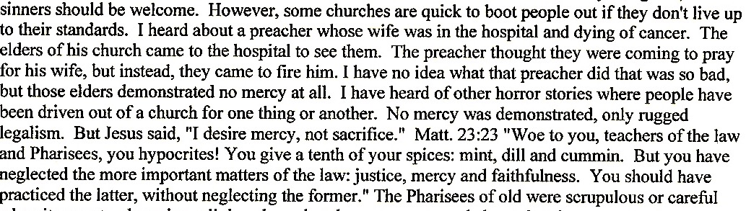
Technical Approach: Context Vectors
Raw Text
Problem Objectives Technical Approach Results
Notes:
Seth

Slide 9
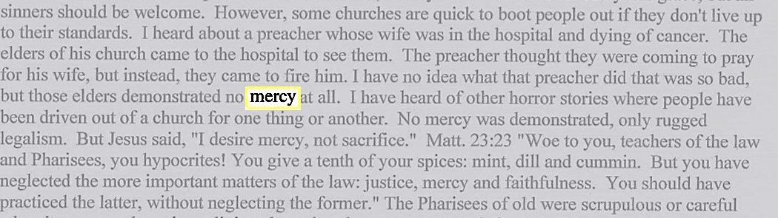
Technical Approach: Context Vectors
Identify Keywords
Problem Objectives Technical Approach Results
Notes:
Seth

Slide 10
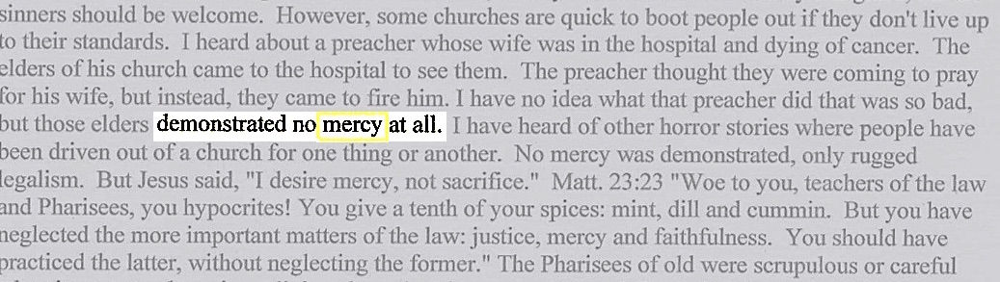
Technical Approach: Context Vectors
Collect words in context vector
Problem Objectives Technical Approach Results
Notes:
Seth

Slide 11
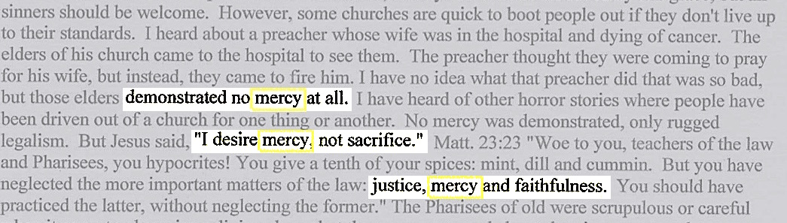
Technical Approach: Context Vectors
Repeat for all occurrences of keyword
Singular Value Decomposition to vector of length 100
Calculate Average Semantic Density and Distributional Co-occurrence Score
Problem Objectives Technical Approach Results
Notes:
Seth

Slide 12
Value Words
Previous Method
TFIDF Method w/Pronouns
TFIDF Method w/out Pronouns
Problem Objectives Technical Approach Results
Notes:
Seth/Sam

Slide 13
Judgment Classification
Previous Method:
Judgment = (noun + “to be” verb + adj/adv)
New Method:
Judgment = pronoun + key word
Problem Objectives Technical Approach Results
Notes:
Megan

Slide 14

Model Revisions
Instead of scoring groups, we’re moving towards a model that will score individual documents.
Lead to temporal analysis
3
4
5
5
Problem Objectives Technical Approach Results
Notes:
Leigh

Slide 15
Technical Approach: Deep Learning
 | peace | catholic | holy
document_001 | 0 | 1 | 0
document_002 | 3 | 0 | 5
document_003 | 0 | 0 | 0
 | Bahai | Dorothy Day | Integral Yoga | Sea Shepherds
document_001 | 0 | 1 | 0 | 0
document_002 | 1 | 0 | 0 | 0
document_003 | 0 | 0 | 0 | 1
Multinomial regression classifier
Let the program learn which words are important
Problem Objectives Technical Approach Results
Notes:
Leigh

Slide 16
Expected Results
Text
7
Problem Objectives Technical Approach Results
Notes:
Leigh

Slide 17
Expected Results
7
Problem Objectives Technical Approach Results
Notes:
Leigh

Slide 18
Questions?
Notes:
Sam

Slide 19
References
Venuti, Sachtjen, McIntyre, Mishra, Hays, Brown. 2016. Predicting the tolerance level of religious discourse through computational linguistics. In 2016 IEEE Systems and Information Engineering Design Symposium (SIEDS), pages 309–314. IEEE.
Venuti, McIntyre, Brown. “Optimization of the Modeling Approach for Predicting the Tolerance Level of Religious Discourse”, unpublished.
Hacker, Boje, Nisbett, Abdelali and Henry. “Interpreting Iranian Leaders’ Conflict Framing by Combining Latent Sentiment Analysis and Pragmatist Story Telling Theory,” National Communication Association Annual Conference, November 23, 2013.
Bullinaria and Levy, “Extracting Semantic Representations from Word Co-occurance Statistics: A Computational Study,” Behavior Research Methods, 2007.
Nielsen, “Neural Networks and Deep Learning”, Determination Press, 2015. http://neuralnetworksanddeeplearning.com/index.html
Janusz, Stawicki, Nguyen. 2014. Adaptive Learning for Improving Semantic Tagging of Scientific Articles. Proceedings of the 2014 Federated Conference on Computer Science and Information Systems, pages 27–34.
Meyer, “A TensorFlow Tutorial: Email Classification”, 2016. http://jrmeyer.github.io/tutorial/2016/02/01/TensorFlow-Tutorial.html

